Slide 1
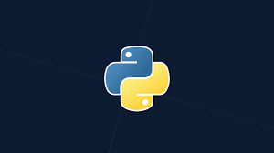
INTRODUCTION TO PYTHON
By:Mohamed Essam

Slide 2
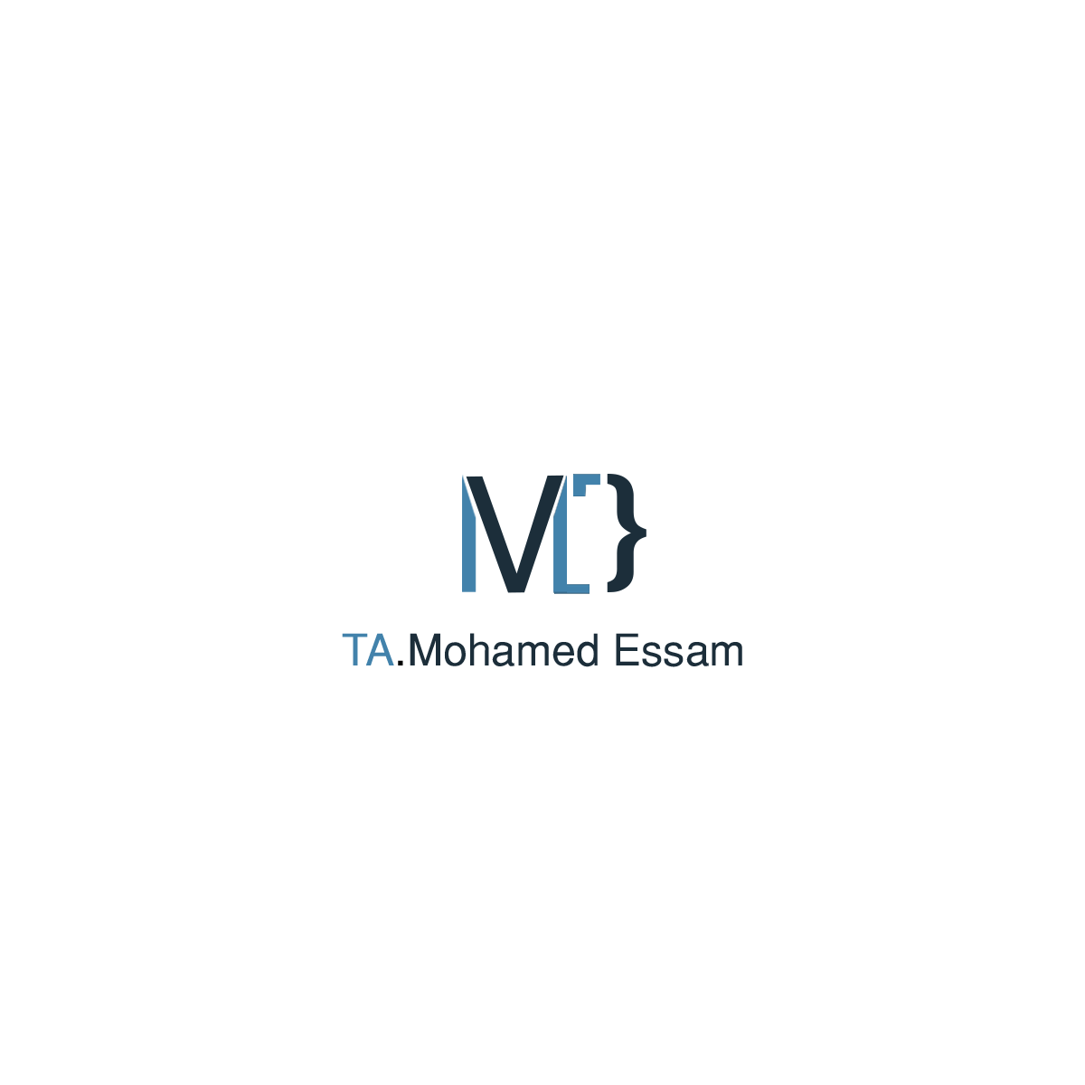
CONTENT OF THIS COURSE
Here’s what you’ll find in this Course :
Introduction to python general-purpose programming language.
What Python Used for.
Companies uses Python.
Setting Up the Environment.
Start Python Programming

Slide 3
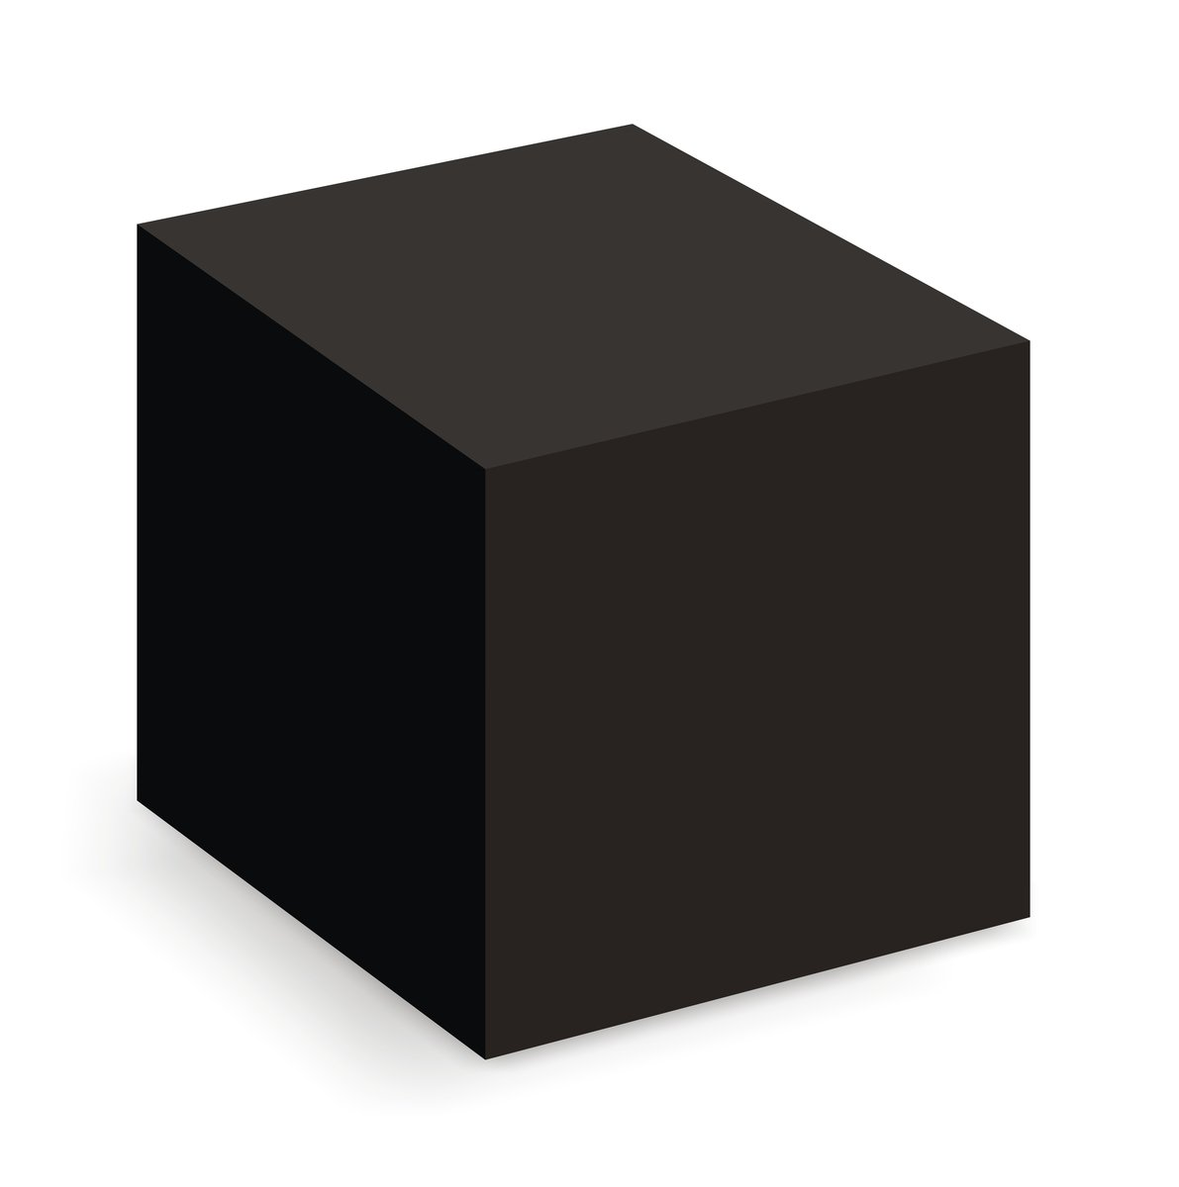
Functions

Slide 4
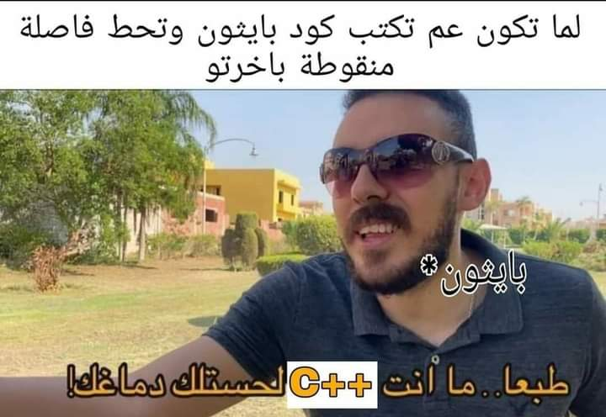
Functions

Slide 5
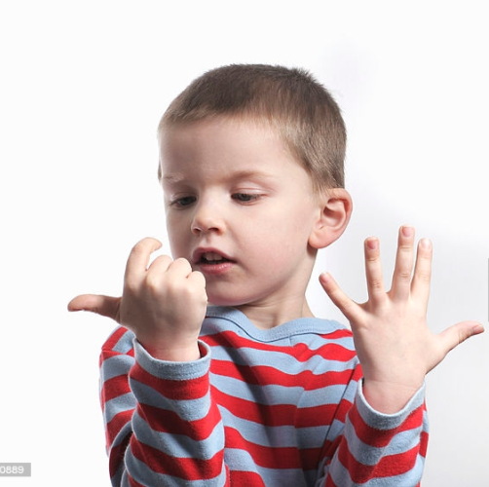
WHAT DOES A COMPUTER DO?
performs calculations a billion calculations per second! two operations in same time light travels 1 foot.
Remembers results
100s of gigabytes of storage!
typical machine could hold 1.5M books of standard size

Slide 6
-Linus Torvalds
“Talk is cheap.
Show me the code.”

Slide 7
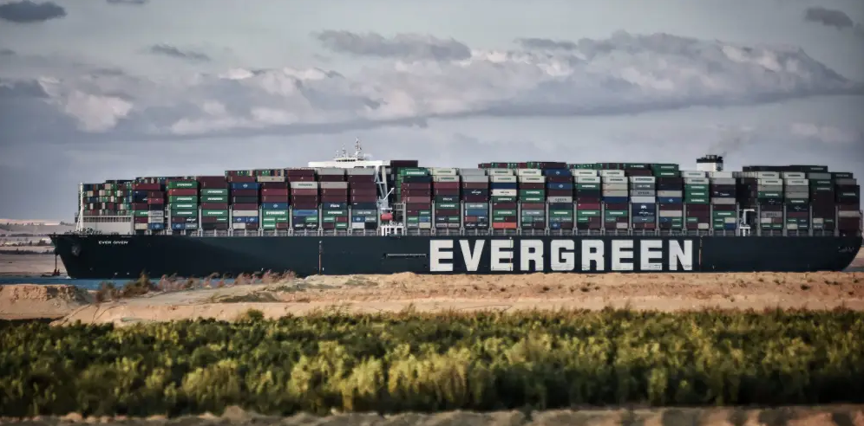
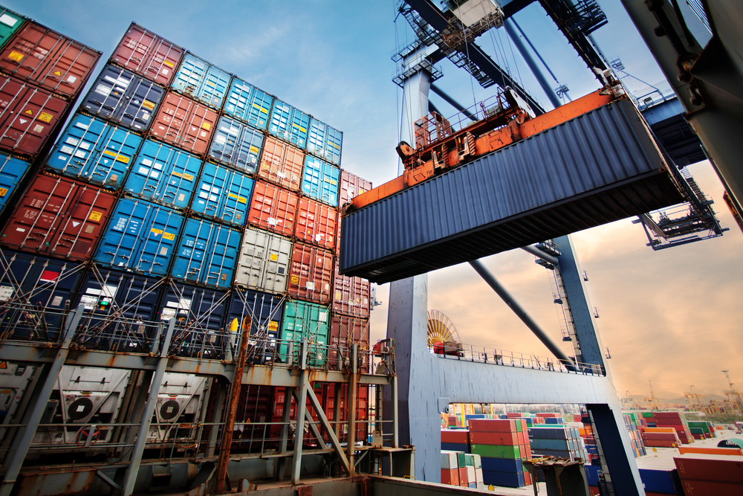
01:Variables

Slide 8
Variables
You can think of variable as a little box or a container to store data in the memory of the computer and later retrieve the data using the variable “name”
Programmers get to choose the names of the variables
You can change the contents of a variable in a later statement

Slide 9
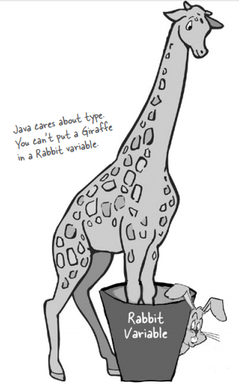
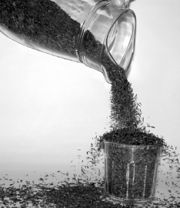
01:Variables

Slide 10
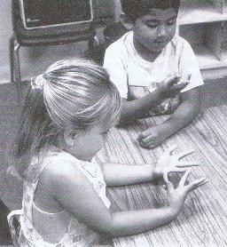
02:Arithmetic Operations
Operation | Operator
Addition | +
Subtraction | -
Multiplication | *
Division | /
Power | **
Remainder | %

Slide 11
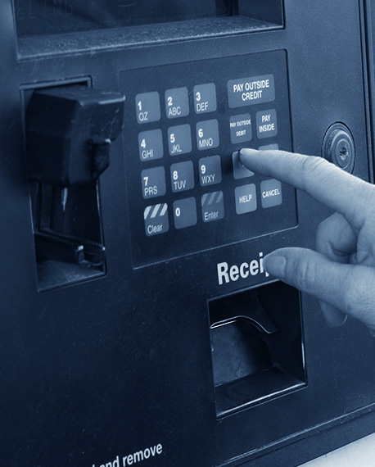
03:User Input
Python has an input function which lets you ask a user for some text input.

Slide 12
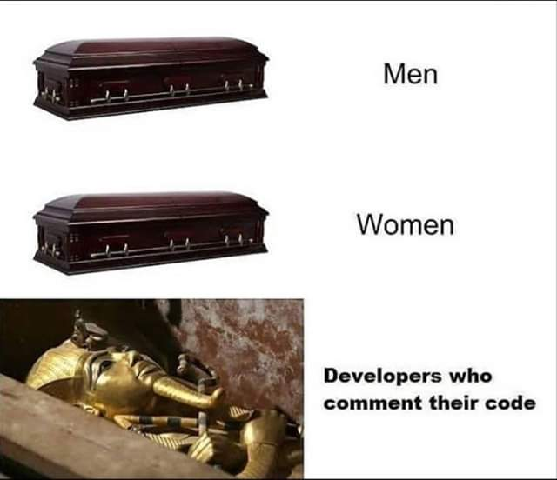
04:Comments in Python
Comments in Python begin with a hash mark ( # ) and whitespace character and continue to the end of the line. Because comments do not execute, when you run a program you will not see any indication of the comment there. Comments are in the source code for humans to read, not for computers to execute.

Slide 13
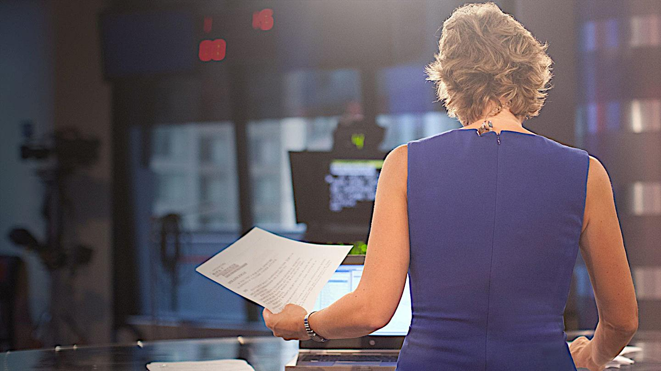
05:Conditions
Python uses boolean logic to evaluate conditions. The boolean values True and False are returned when an expression is compared or evaluated.

Slide 14
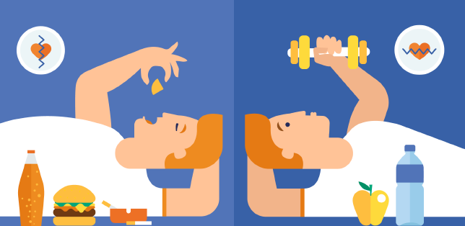
Introduction to AI with ML

Slide 15
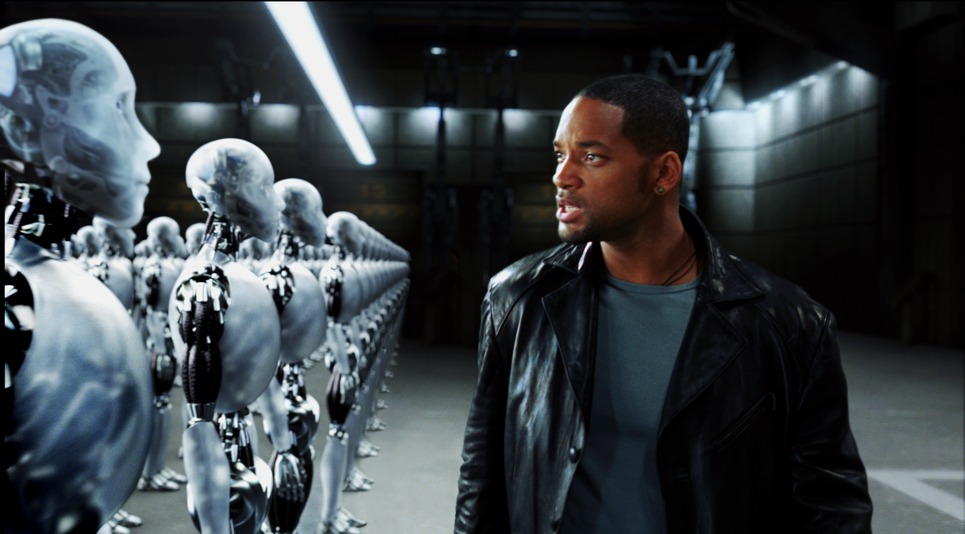
Introduction to AI with ML

Slide 16

06:Loop
Python has two primitive loop commands:
while loops
for loops

